Slide 1
ONLINE COMPLAINT REGISTRATION AND MANAGEMENT SYSTEM
TEAM NUMBER:ADSB42
TEAM MEMBERS:
SUDHIR KUMAR A (211521243157)
THOTA VENKAT SAI (211521243171)
ANNAPUREDDY VENKATA PRATHAP (211521243015)
SUJAN GV (211521243158)

Slide 2
TABLE OF CONTENTS
ABSTRACT
INTRODUCTION
PROPOSED SYSTEM
IMPLEMENTATION: MERN STACK
FRONTED
BACKEND
INTERGRATION
BLOCK DIAGRAM
MODEL SCREENSHOT
CONCLUSION

Slide 3
ABSTRACT
The Online Complaint Registration and Management System is a web-based platform designed to streamline the process of lodging and resolving customer complaints. It enables users to register, submit complaints with relevant details, and track their status in real-time. The system features seamless interaction between users and agents through built-in messaging. Admins manage complaints, assign them to agents, and oversee platform operations. Developed with a React.js frontend and Node.js backend, it leverages MongoDB for data management and ensures secure user authentication. This system enhances customer support efficiency and fosters transparency by providing real-time updates and organized complaint resolution.

Slide 4
INTRODUCTION
The Online Complaint Registration and Management System is designed to improve communication between businesses and customers by providing an efficient platform for managing complaints. Users can easily register grievances, track their status, and interact with support agents through a user-friendly interface. Built with React.js for the frontend and Node.js with MongoDB for the backend, the system ensures robust data handling and secure authentication. By streamlining the complaint process, this project enhances user experience, enables timely resolutions, and equips administrators with tools to monitor complaints, ultimately fostering improved customer service and satisfaction.

Slide 5
PROPOSED SYSTEM
The Online Complaint Registration and Management System is designed to streamline the complaint management process with three user roles: Customer, Agent, and Admin. Customers can register, submit complaints, track their status, and interact with agents. Agents manage assigned complaints, update their statuses, and communicate with customers. Admins oversee the entire system, monitor complaints, assign them to agents, and manage user accounts. The system employs modern technologies, ensuring a responsive design and secure data handling. By facilitating efficient communication and resolution processes, this system enhances customer service and satisfaction while providing valuable insights for continuous improvement.

Slide 6
IMPLEMENTAYION: MERN STACK
FRONTEND
The frontend of the Online Complaint Registration and Management System is built using React.js, providing a dynamic user interface for seamless interaction. It features registration, complaint submission, and tracking forms, enabling users to manage their complaints effectively. Utilizing components such as Registration Form, Complaint Form, and Track Complaint Form, the UI is designed for ease of use and responsiveness. The application integrates Material UI for modern styling and Axios for API communication, ensuring smooth data retrieval and submission. React Router facilitates navigation between different sections, enhancing user experience and allowing easy access to functionalities like user profiles and complaint dashboards.

Slide 7
BACKEND
The backend of the Online Complaint Registration and Management System is developed using Node.js and Express.js, creating a robust server that handles API requests. MongoDB serves as the database, storing user information, complaints, and their statuses. The backend implements Mongoose for schema management, enabling efficient data manipulation through CRUD operations. User authentication is secured using JSON Web Tokens (JWT) for session management. API routes are organized to handle user registration, complaint submission, and status updates. Middleware, such as body-parser and cors, is configured for request parsing and cross-origin resource sharing, ensuring smooth communication between the frontend and backend components.

Slide 8
INTEGRATION
The integration of the Complaint Registration and Management System involves connecting the backend and frontend components. The backend, built with Node.js and Express, handles API requests for creating and retrieving complaints, using MongoDB for data storage. The frontend, developed with React, provides a user interface where users can submit complaints and view the list of registered complaints. Axios is used to make HTTP requests from the React components to the Express API. The backend server runs on one port (e.g., 5000), while the React app runs on another (e.g., 3000), enabling seamless communication between the two.

Slide 9
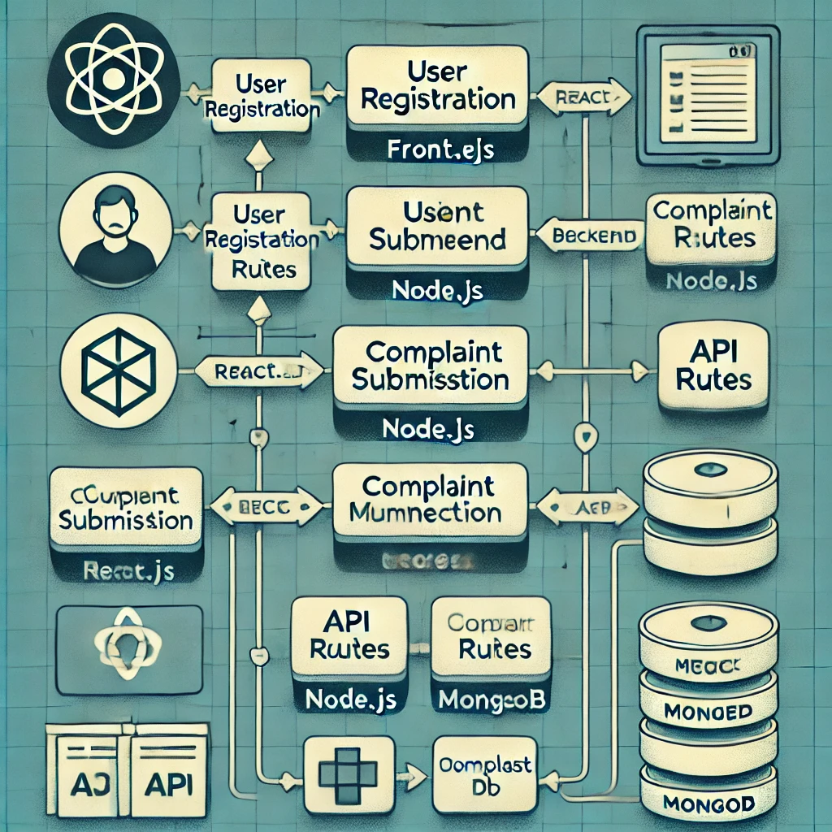
BLOCK DIAGRAM

Slide 10
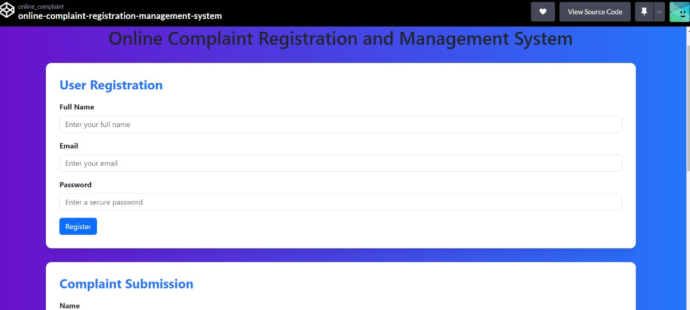
MODEL SCREENSHOT

Slide 11
CONCLUSION
In conclusion, the Complaint Registration and Management System effectively demonstrates the capabilities of the MERN stack by integrating MongoDB, Express, React, and Node.js. This project provides a user-friendly interface for submitting and managing complaints, showcasing the seamless interaction between the frontend and backend through RESTful APIs. The implementation can be further enhanced by adding features such as user authentication, complaint tracking, and notifications. Overall, this system serves as a solid foundation for developing scalable web applications, highlighting the versatility and efficiency of the MERN stack in real-world scenarios.

Slide 12
THANK YOU

